Slide 1
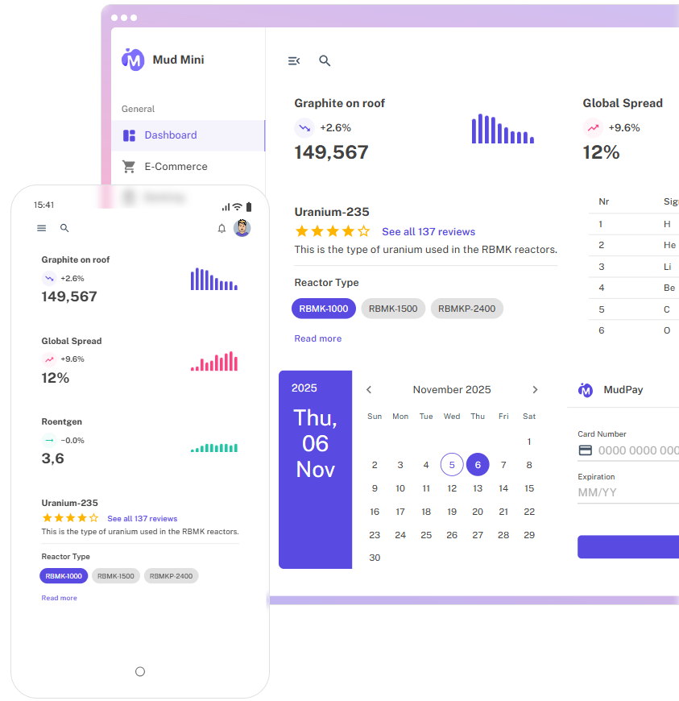
The Blazor
Component Library
You I’ve always wanted
Notes:
Show of hands:
Who HASN’T worked with Blazor
Who works a lot on dashboard-like sites

Slide 2


About me
René Sackers
.NET “developer” since 2006
At Beter Bed since 2019
Married 20th June
Reach me at:
  GitHub - @Rene-Sackers
  LinkedIn
  .NET Zuid meetings!
Notes:
Beter Bed -> long enough -> don’t tell boss
Sleeping on job -> don’t tell boss
Speaking of boss, he’s here tonight, so disregard the previous

Slide 3
Contents
Quick overview
Setup
Themes, styling, CSS
Notable components
In practice
Extensions (if time allows)

Slide 4
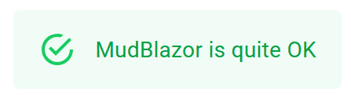
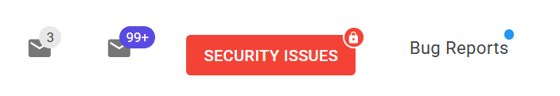

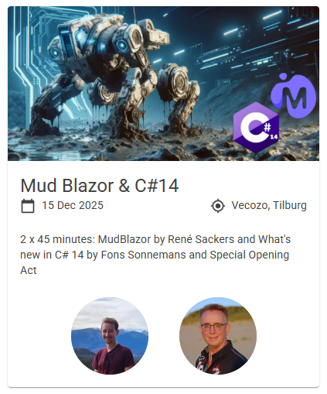
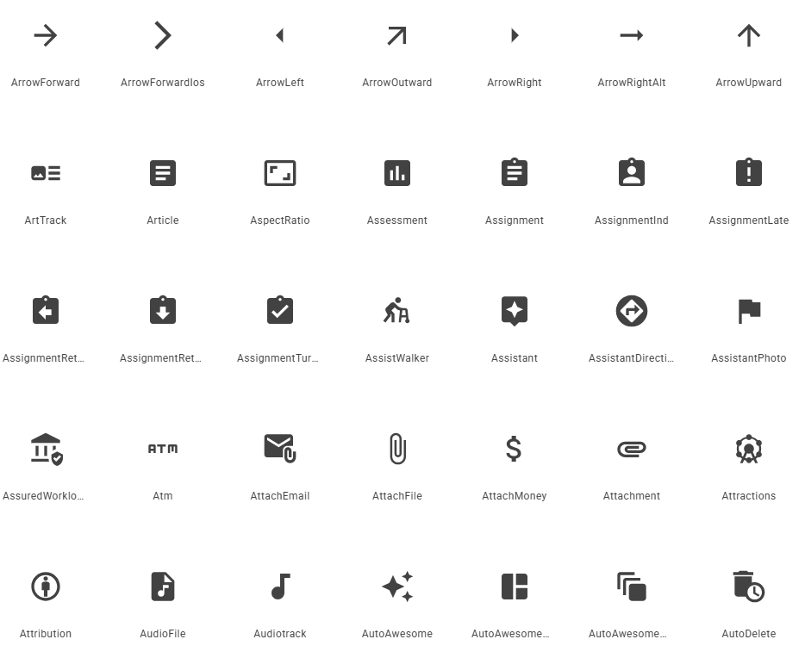

Quick overview
Notes:
MUD Blazor = Material User Design… Blazor

Slide 5
Setup
dotnet new mudblazor
  dotnet new install MudBlazor.Templates
  dotnet new mudblazor --name MyApplication --all-interactive --interactivity Auto
  dotnet new mudblazor --name MyApplication --all-interactive --interactivity Server
  dotnet new mudblazor --name MyApplication --all-interactive --interactivity WebAssembly
Manual
Notes:
Sidenote: all interactive REQUIRED due to main layout components
Manual: https://mudblazor.com/getting-started/installation#manual-install-add-components

Slide 6
Themes, styling, CSS
Customizability
Dark/light themes
Out-of-the-box CSS classes
  Margin
  Padding
  Flexbox

Slide 7
Notable components
Components
  Grid
  Snackbar
  MessageBox
  Table
  …

Slide 8
MudBlazor in practice
QR code tool
Cross sell tool
Promotion tool
3D Boxspring configuration tool configuration tool
Notes:
QR tool
Azurite -> QR
Docker -> MSSQL
Cross sell tool
Docker -> MSSQL
Promotion tool
Azurite -> Backend

